Slide 1
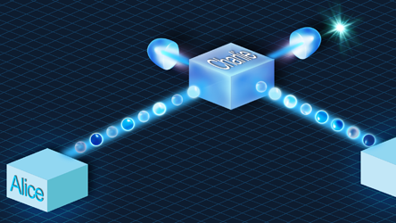
Update meeting 2
Joan, Juan & Timo

Slide 2
Our plans for the project
Implement BB84 on Quantum Inspire Simulator
Implement ‘cleanest’ version
Implement the program on Starmon-5
See influence of physical errors
Implement the program on IBM and microsoft backends
Compare even more different types of qubits
Explore Eve posibilities
Explore classical protocols like privacy amplification
Compare the two systems in performance
Implement E91 protocol on the simulator and QuantumInspire hardware
Compare performance with the BB84 protocol and try to explain differences.

Slide 3
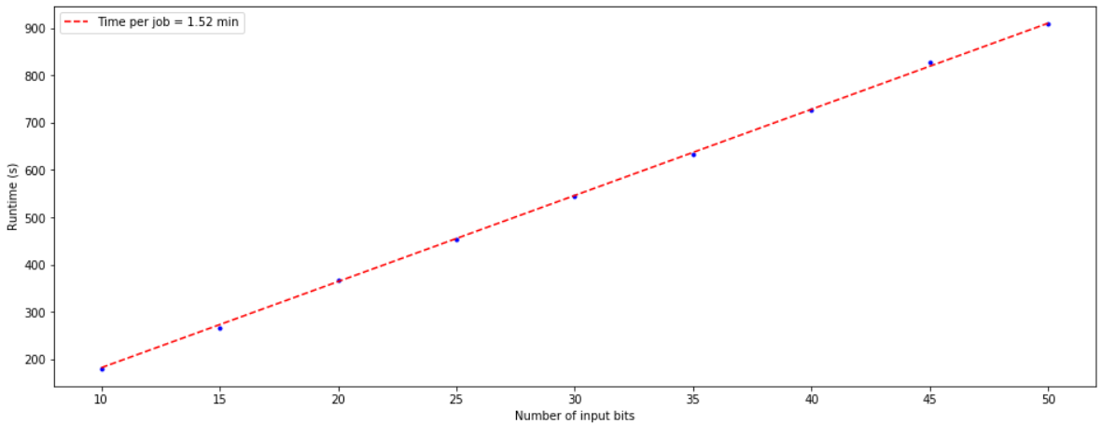
First attempt: 5 key bits per job

Slide 4
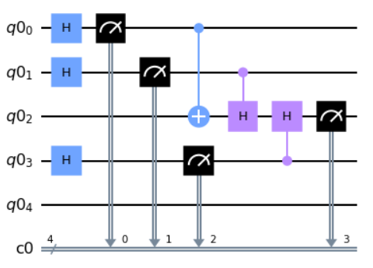
Then: (intrinsic) Quantum Randomness

Slide 5
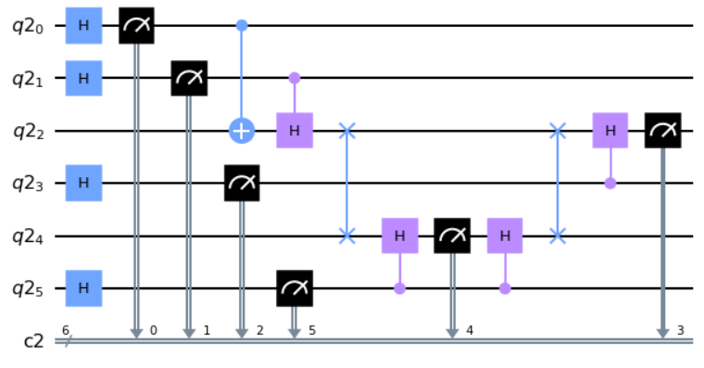
Eve implementation
More than 5 qubits…

Slide 6
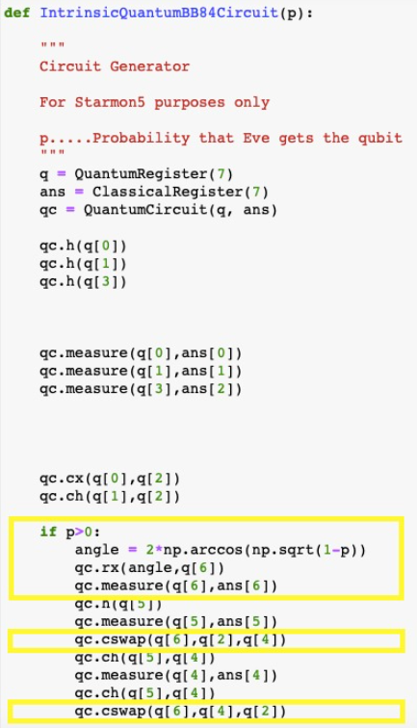
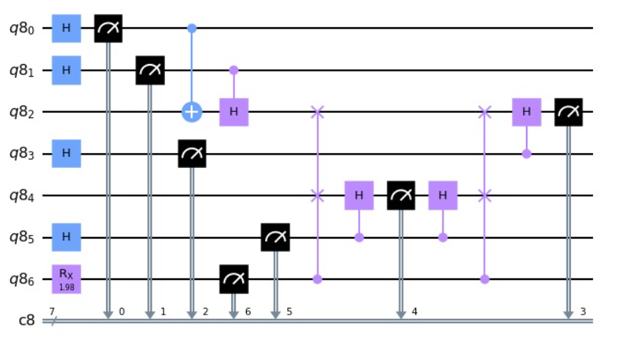
Probabilistic Eve implementation

Slide 7
Overview
Done
Implement Quantum Randomness
To Do (this week)
Eve (Man in the middle) with quantum randomness
Questions
Is one shot per key bit good enough for physical systems?
Is there any way to perform multiple measurements on 1 qubit in 1 job
Is it possible to study Eve with the simulator and study errors on Starmon-5 seperately?
Juan: Privacy amplification + bit comparison theory
Joan: Eve implementation with quantum randomness (hopefully using 5 qubits)
Timo: Implement on Starmon-5 and analyze error rates

